Slide 1


Disleve Kanku
1/12/2022

Slide 2

Outline
Executive Summary
Introduction
Methodology
Results
Conclusion
Appendix

Slide 3
Executive Summary
Summary of methodologies:
Collected Data through API
Collected Data by web scraping
Data Wrangling
Exploratory Data Analysis with SQL
Exploratory Data Analysis with Data Visualization
Interactive visual Analytics with Folium
Machine learning Prediction
Summary of all results
Exploratory Data Analysis result
Interactive analytics in screenshots
Predictive Analytics result

Slide 4
Introduction
Project background and context
SpaceX advertises Falcon9 rockets with a cost of 62 million dollars while other providers cost more than 150 million dollars, this is due to SpaceX’s ability to reuse the first stage. The ability to determine if the first stage will successfully land is crucial in estimating the cost of a launch. The goal of the project is to create a machine learning algorithm that will predict the success rate of the first stage landing
Problems you want to find answers
factor’s that will determine the success rate of the rocket landing
Interactions amongst different factors in determining success rate
What conditions need to be taken into consideration for a successful landing

Slide 5


Slide 6
Methodology
Executive Summary
Data collection methodology:
Data was collected from SpaceX API and web scraping from google
Perform data wrangling
One-hot encoding was applied to categorical features
Perform exploratory data analysis (EDA) using visualization and SQL
Perform interactive visual analytics using Folium and Plotly Dash
Perform predictive analysis using classification models
How to build, tune, evaluate classification models

Slide 7
Data Collection
Describe how data sets were collected.
Data collection was done using get request to the SpaceX API
Decoded the response content as json and converted it into a pandas dataframe
Cleaned the data by replacing missing values

Slide 8
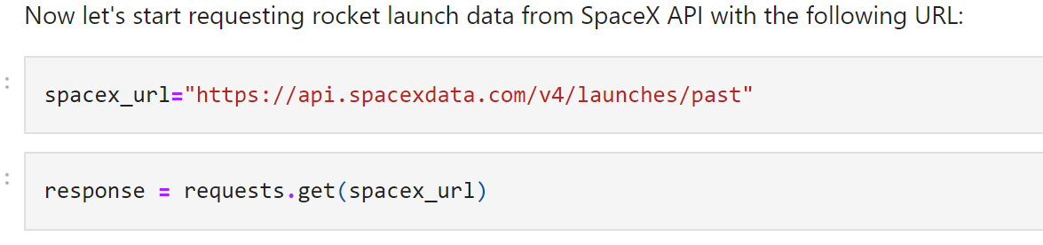
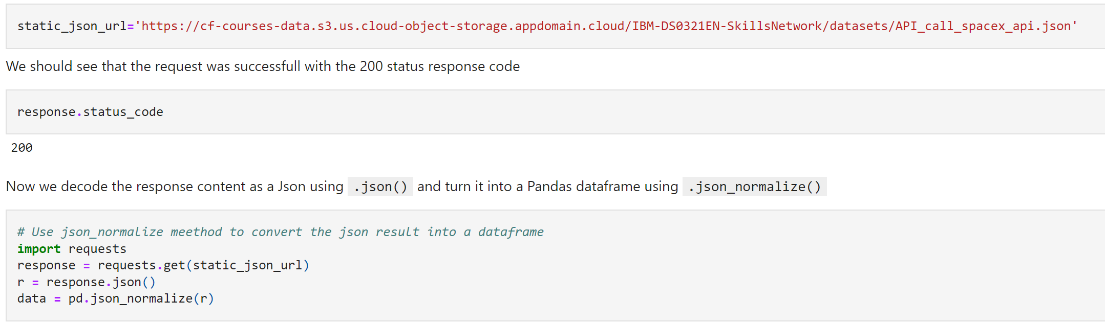
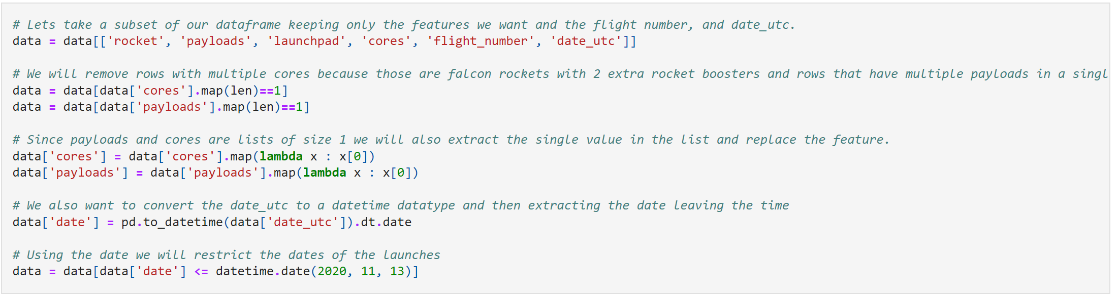
Data Collection – SpaceX API
I collected data from the SpaceX Api by using the get request, cleaned and formatted the data
The link to the notebook is
https://github.com/Dislevekanku/projectrepo/blob/master/Data%20collection.ipynb
Place your flowchart of SpaceX API calls here

Slide 9
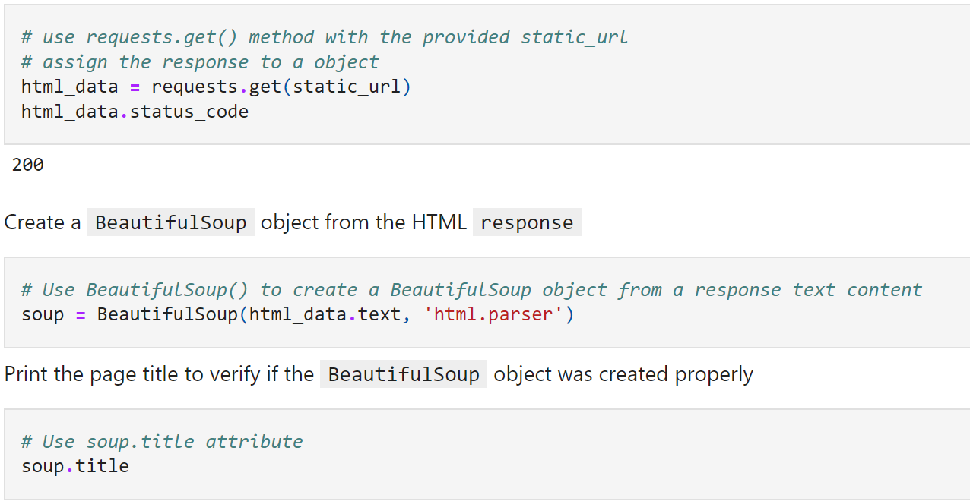
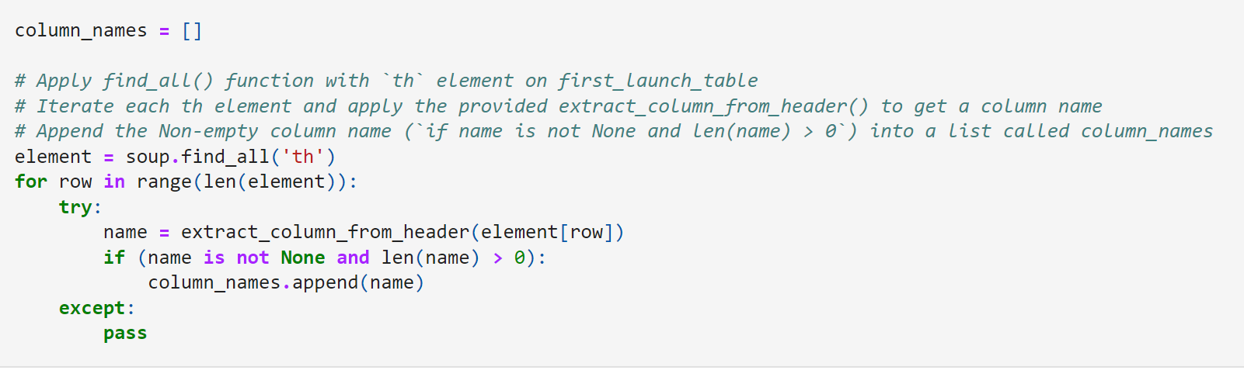
Data Collection - Scraping
Used BeautifulSoup to webscrap Falcon 9 launch records
Parsed the table and converted it into a pandas dataframe
The link to the notebook is
https://github.com/Dislevekanku/projectrepo/blob/master/Data%20collection%20with%20webscrapping.ipynb
Place your flowchart of web scraping here

Slide 10
Data Wrangling
Performed exploratory data analysis and determined the training labels
Calculated the number of launches at each site, as well as the number of occurrences of each orbit
Created the landing outcome label from the outcome column and exported the results to a csv
The link to the notebook is
https://github.com/Dislevekanku/projectrepo/blob/master/Data%20wrangling.ipynb

Slide 11
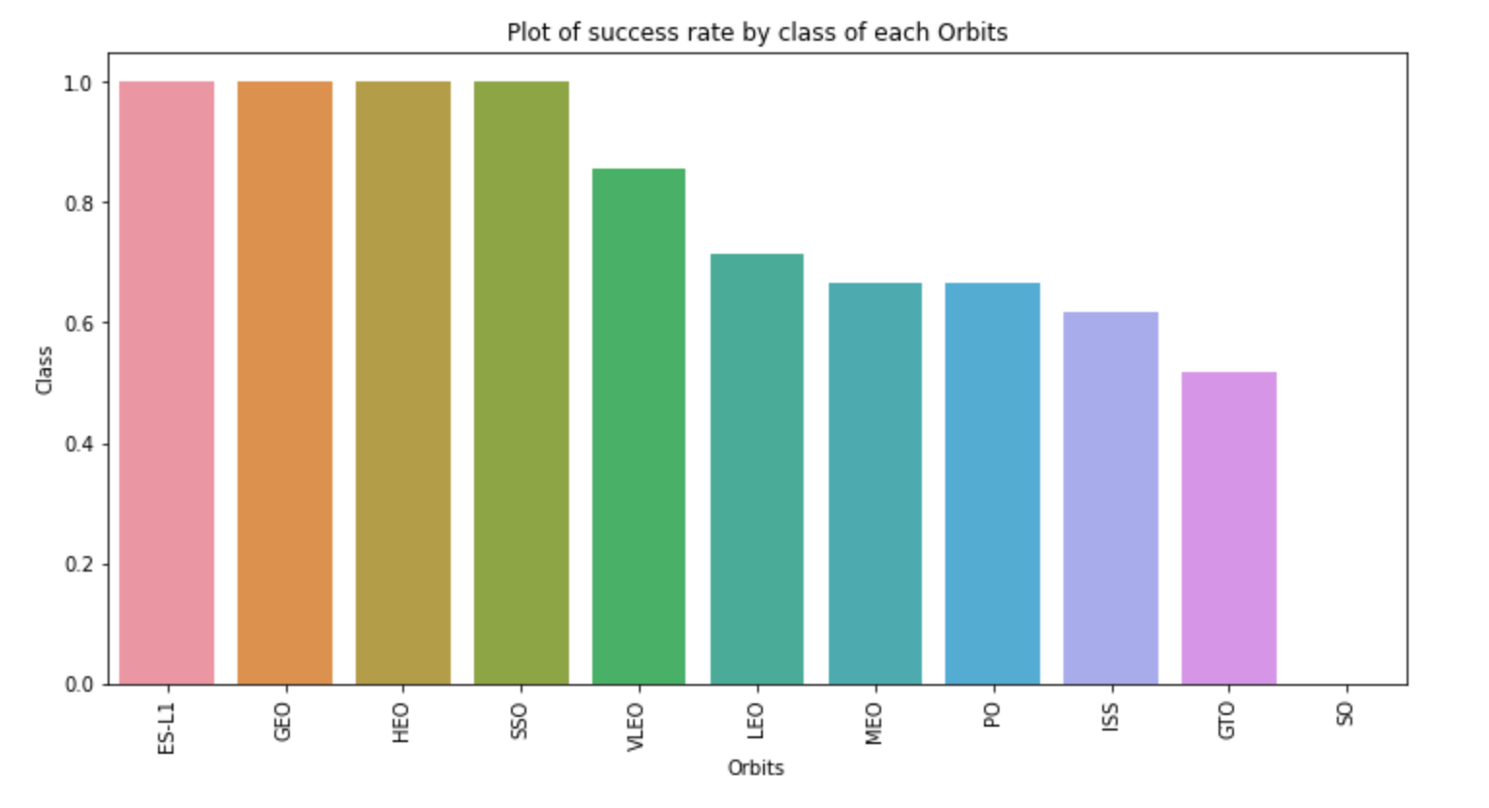
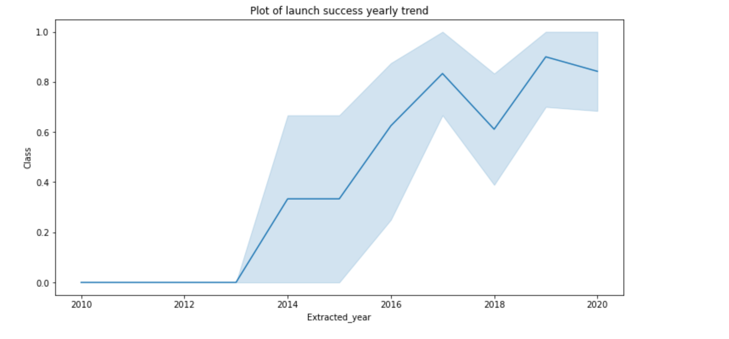
EDA with Data Visualization
Explored the relationship between flight number and launch Site, payload and launch Site, success rate of each orbit type, flight number and orbit type.
The link to the notebook is
https://github.com/Dislevekanku/projectrepo/blob/master/Data%20Visualization.ipynb

Slide 12
EDA with SQL
I applied EDA with SQL to get insight from the data. I wrote queries to solve:
The names of unique launch sites in the space mission.
The total payload mass carried by boosters launched by NASA(CRS)
The average payload mass carried by booster version F9 v1.1
The total number of successful and failure mission outcomes
The failed landing outcomes in drone ship, their booster version and launch site names.
The link to the notebook is https://github.com/Dislevekanku/projectrepo/blob/master/EDA%20with%20SQL%20lab.ipynb

Slide 13
Build an Interactive Map with Folium
I marked all launch sites, and added map objects such as markers, circles, lines to mark the success or failure of launches for each site
I assigned the feature launch outcomes(failure or success) to class ) and 1 respectively
Using color-labeled marker clusters, I identified which launch sites have a high success rate
The link to the notebook is https://github.com/Dislevekanku/projectrepo/blob/master/interactive%20Visual%20Analytics%20with%20Folium%20lab.ipynb

Slide 14
Build a Dashboard with Plotly Dash
I built an interactive dashboard with Plotly Dash
I plotted a pie chart showing the total launches by a certain site
I plotted a scatter graph showing the relationship between outcome and payload mass(Kg) for different booster version

Slide 15
Predictive Analysis (Classification)
Loaded the data using numpy, transformed and split the data into training and testing set.
Built different machine learning models and tuned different hyperparameters using GridSearchCV
Used accuracy as the metric for the models
The link to the notebook is https://github.com/Dislevekanku/projectrepo/blob/master/machine%20learning%20prediction.ipynb

Slide 16
Results
Exploratory data analysis results
Interactive analytics demo in screenshots
Predictive analysis results

Slide 17


Slide 18
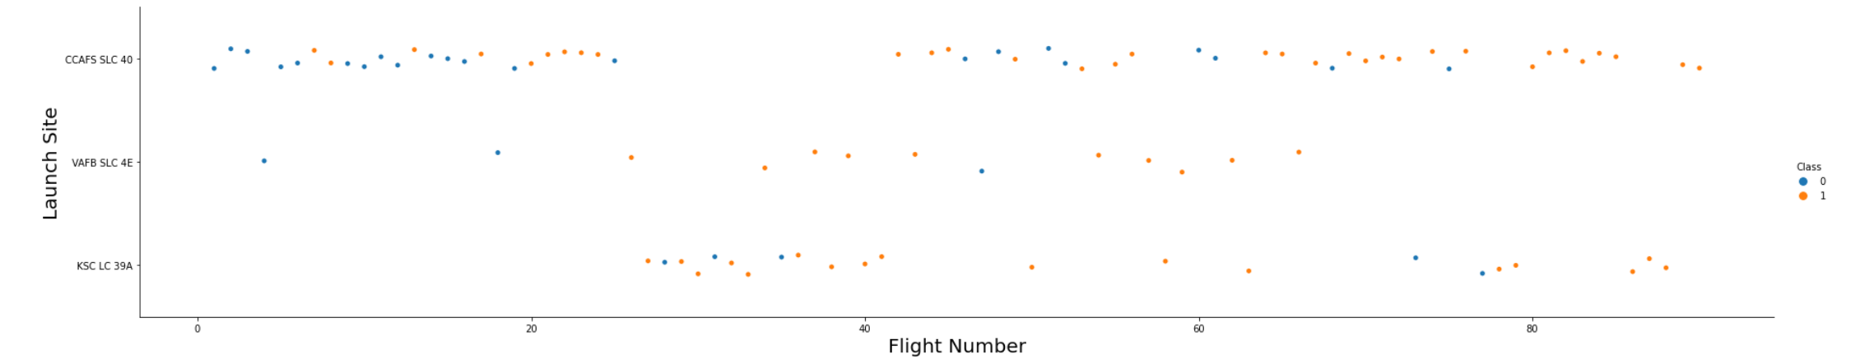
Flight Number vs. Launch Site
From the scatter plot, I found that as the number of flights at a launch site increases, the greater the success rate at the launch site.

Slide 19
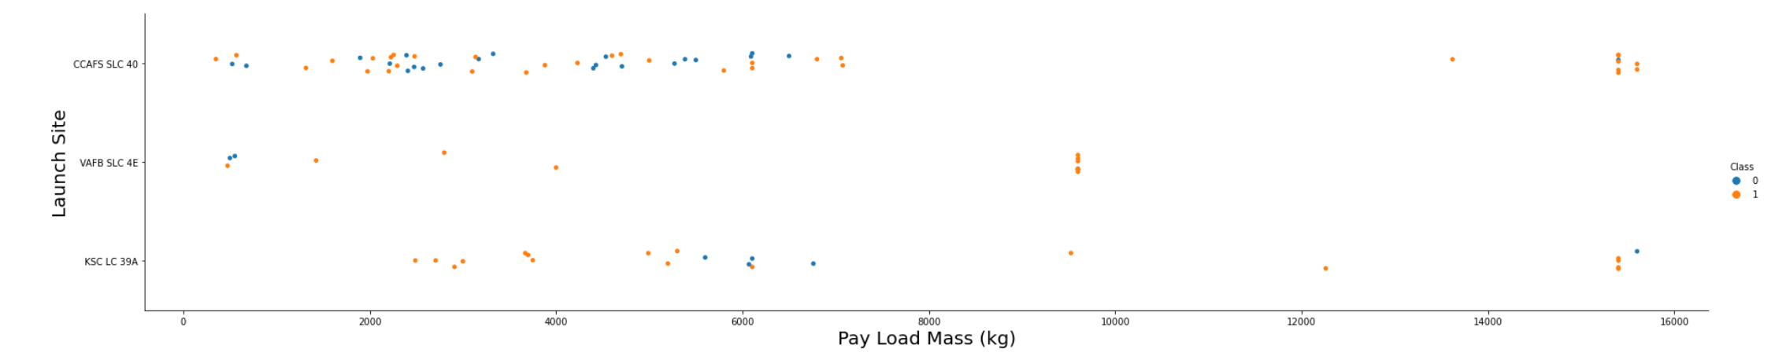
Payload vs. Launch Site
The greater the payload mass for launch site CCAFS SLC 40, the higher the success rate for the rocket

Slide 20
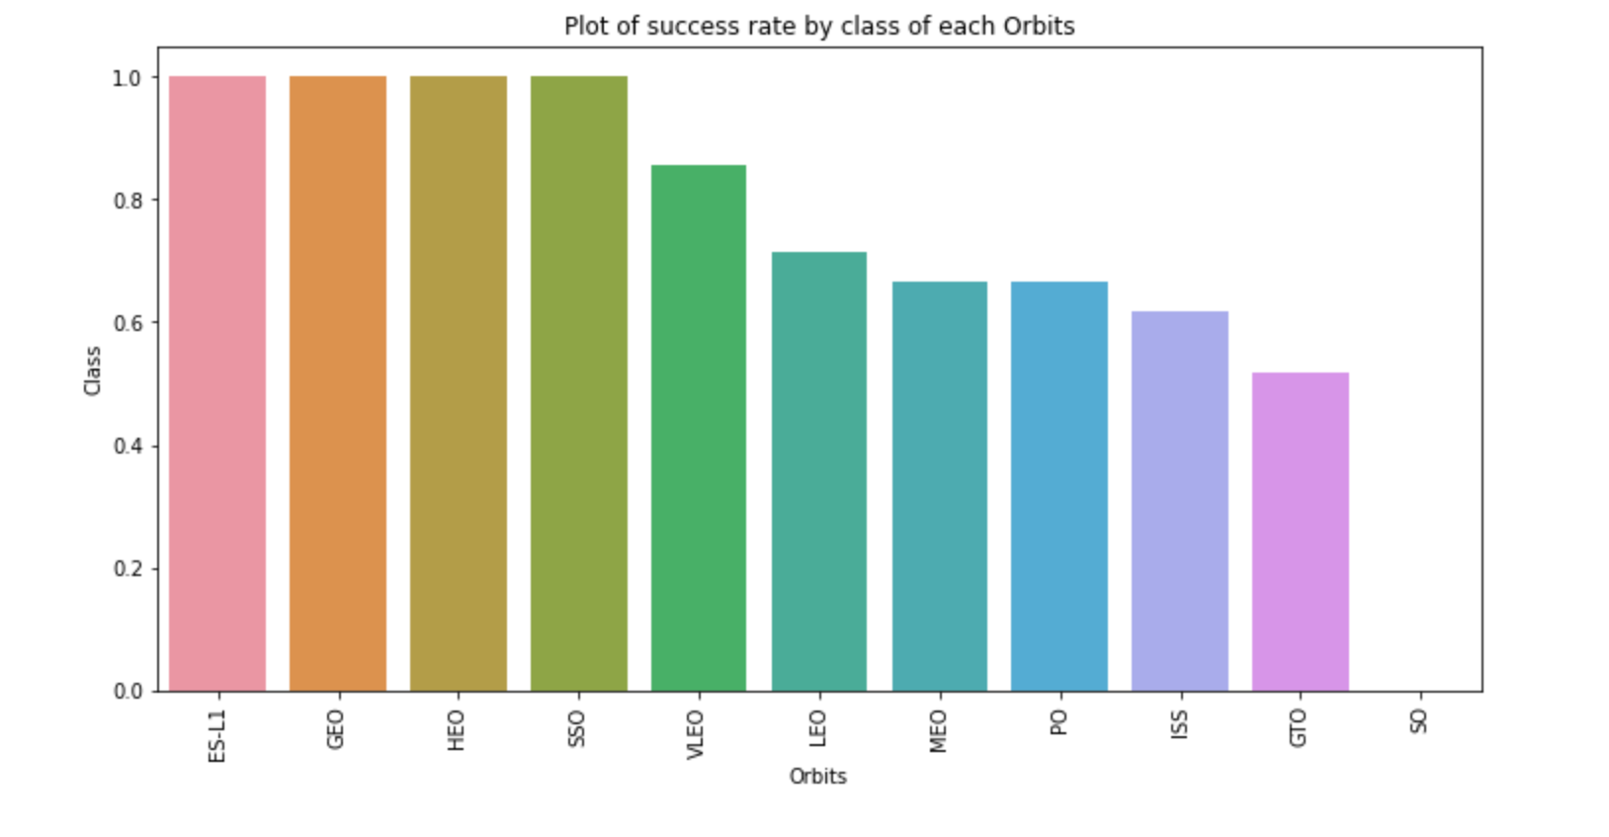
Success Rate vs. Orbit Type
From the plot, we observe that ES-L1, GEO, HEO, and SSO had the most success rate

Slide 21
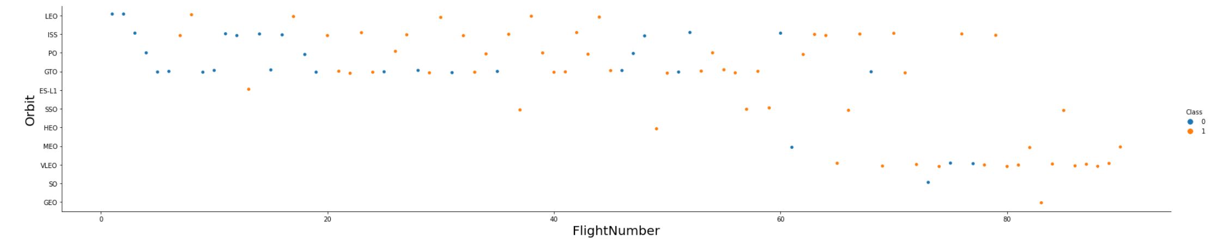
Flight Number vs. Orbit Type
From the plot below, we observe that in the LEO orbit, there is a relationship between success and the number of flights while in the GTO orbit, there is no relationship between these two factors

Slide 22
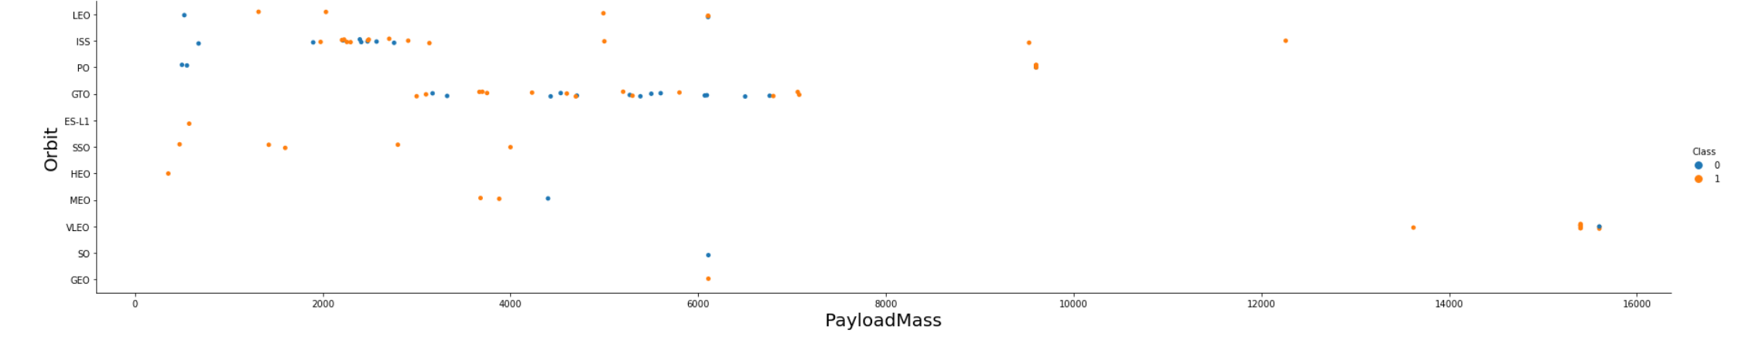
Payload vs. Orbit Type
We can conclude that, there is more successful landing with heavy payloads for PO,LEO and ISS orbits

Slide 23
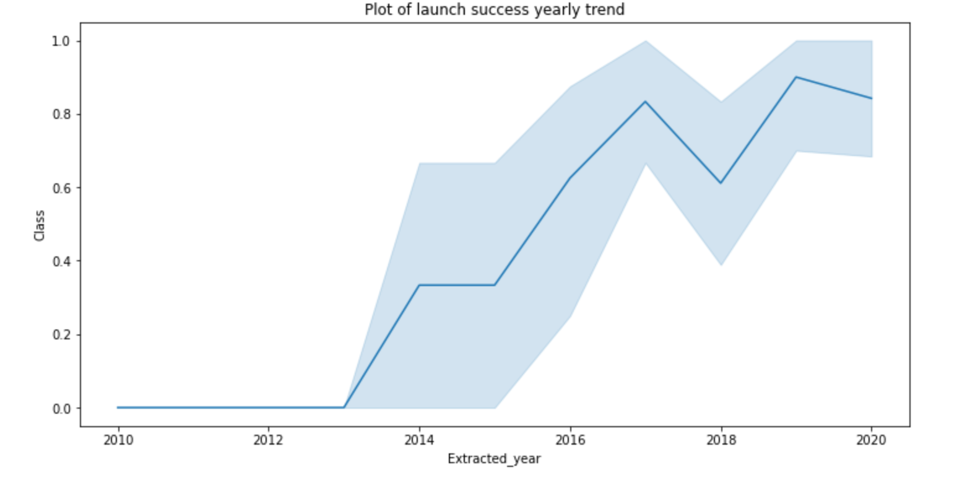
Launch Success Yearly Trend
From the plot, we observe an increase in success rate since 2013

Slide 24
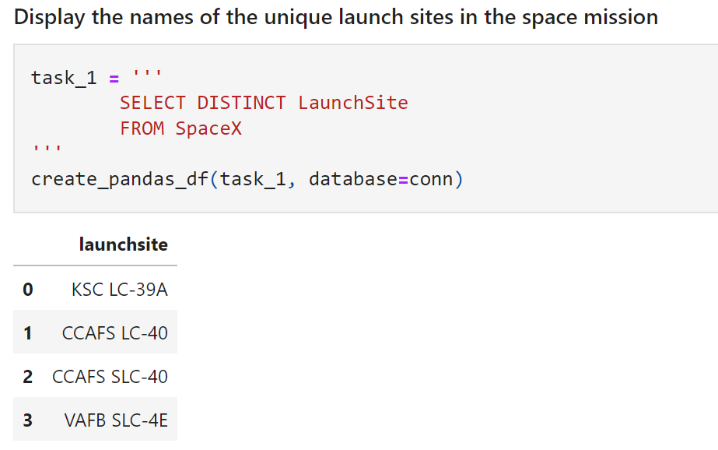
All Launch Site Names
I used the keyword DISTINCT to show only unique launch sites from the SpaceX data.

Slide 25
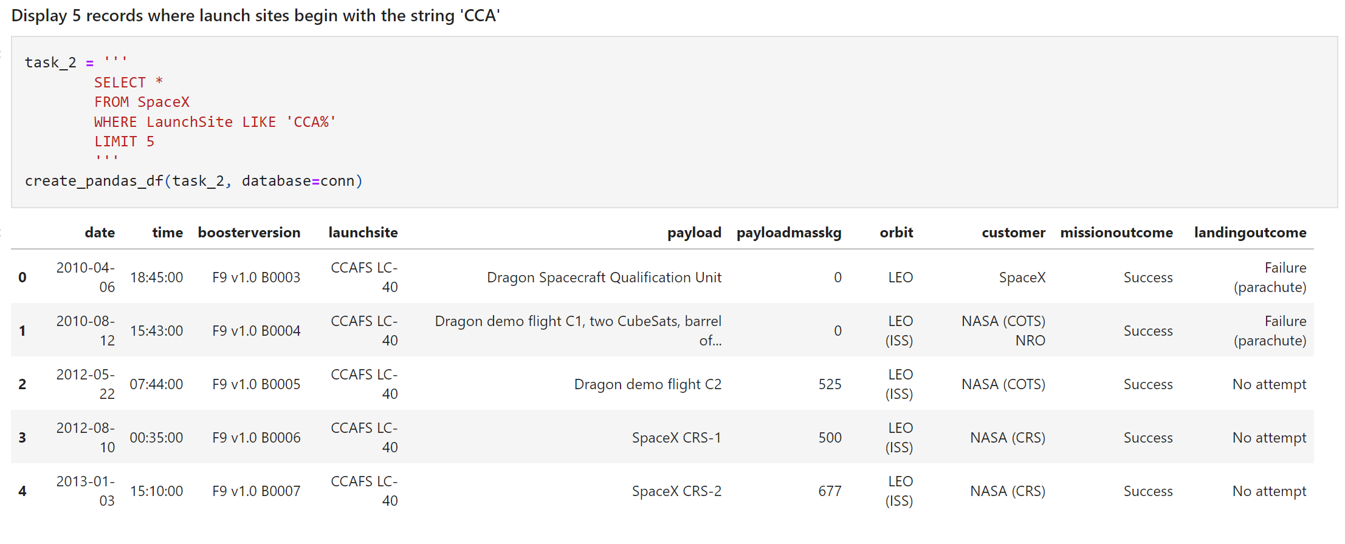
Launch Site Names Begin with 'CCA'
Used the query below to display 5 records where launch sites begins with ‘CCA’

Slide 26
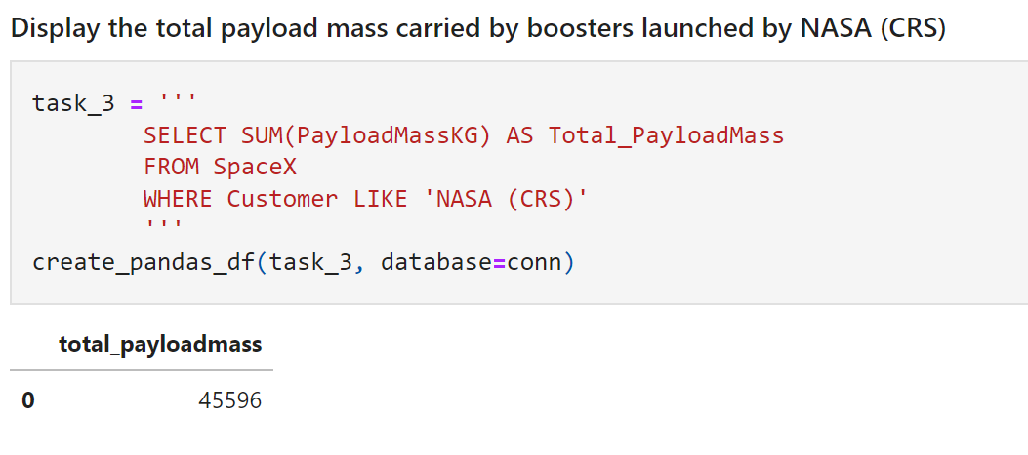
Total Payload Mass
Found the value of 45596 as the total payload carried by boosters from NASA.

Slide 27
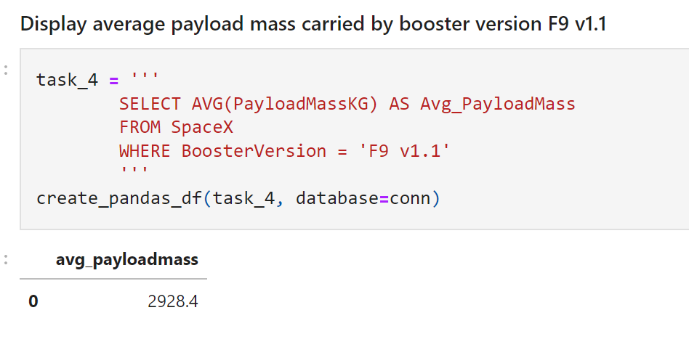
Average Payload Mass by F9 v1.1
Found a value of 2928.4 as the average payload mass carried by booster version F9 v1.1

Slide 28
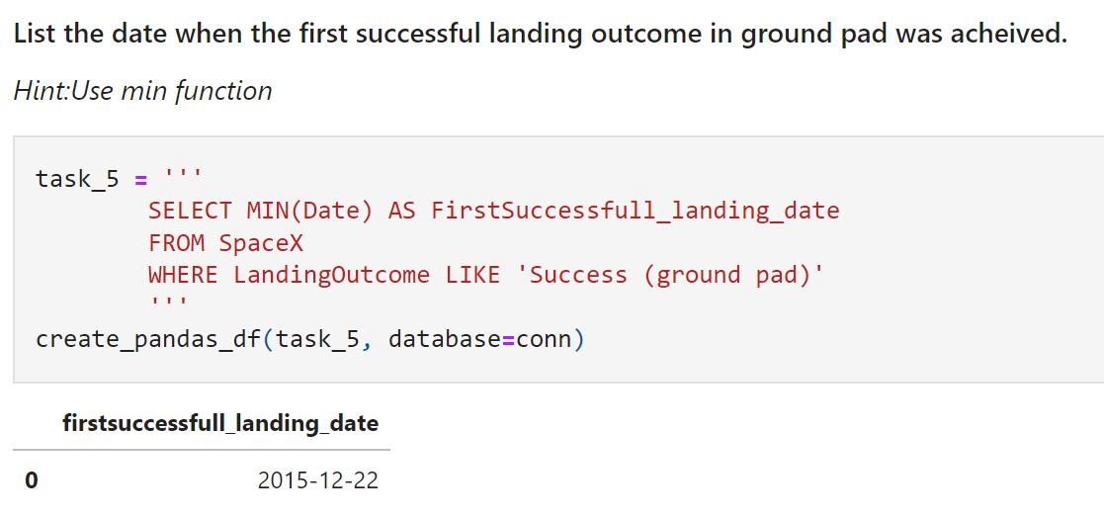
First Successful Ground Landing Date
Observed that the first successful landing on ground pad was recorded on December 22nd, 2015.

Slide 29
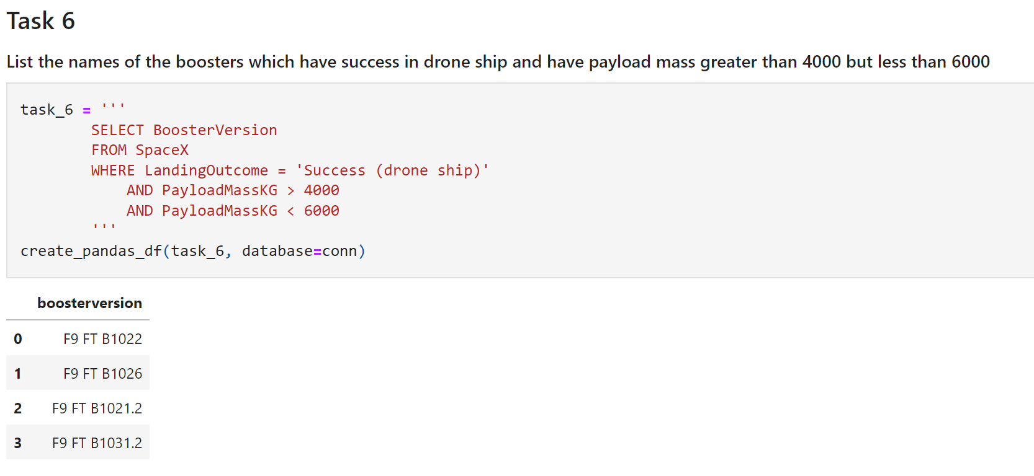
Successful Drone Ship Landing with Payload between 4000 and 6000
Used the WHERE clause to find boosters that successfully landed on drone ship and applied the AND clause to determine successful landing when the payload mass is between 4000 and 6000.

Slide 30
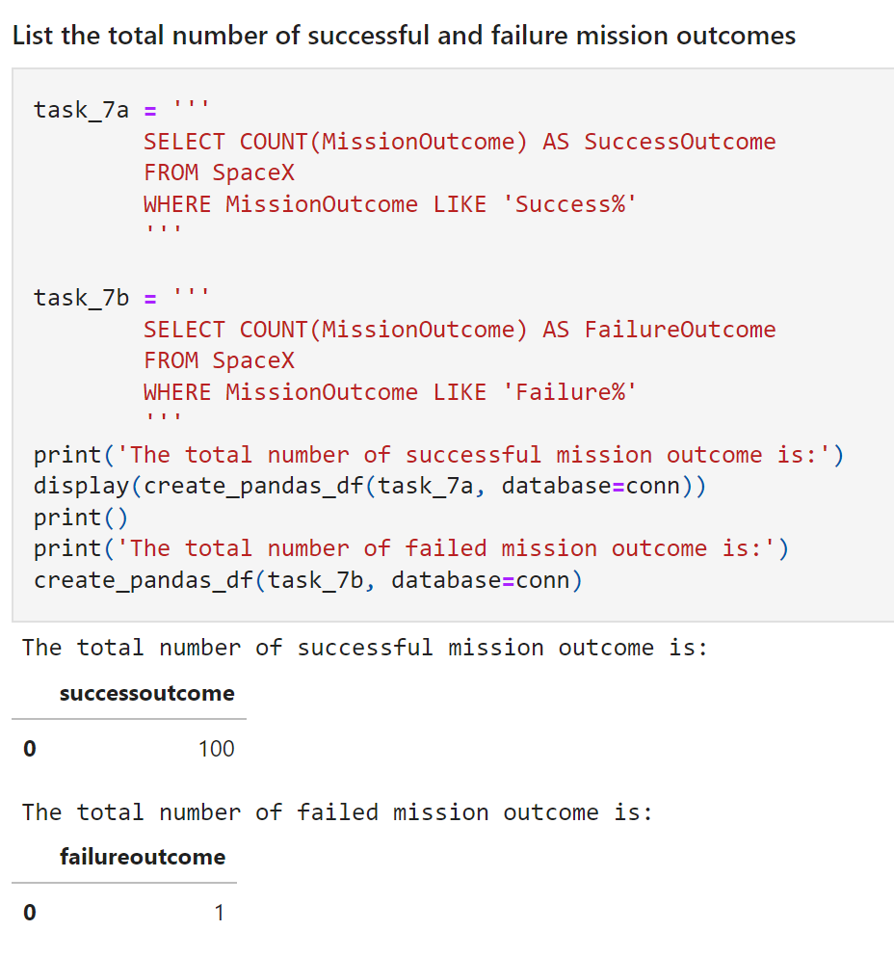
Total Number of Successful and Failure Mission Outcomes
Used the clause ‘%’ to filter whether the mission outcome was a success or failure.

Slide 31
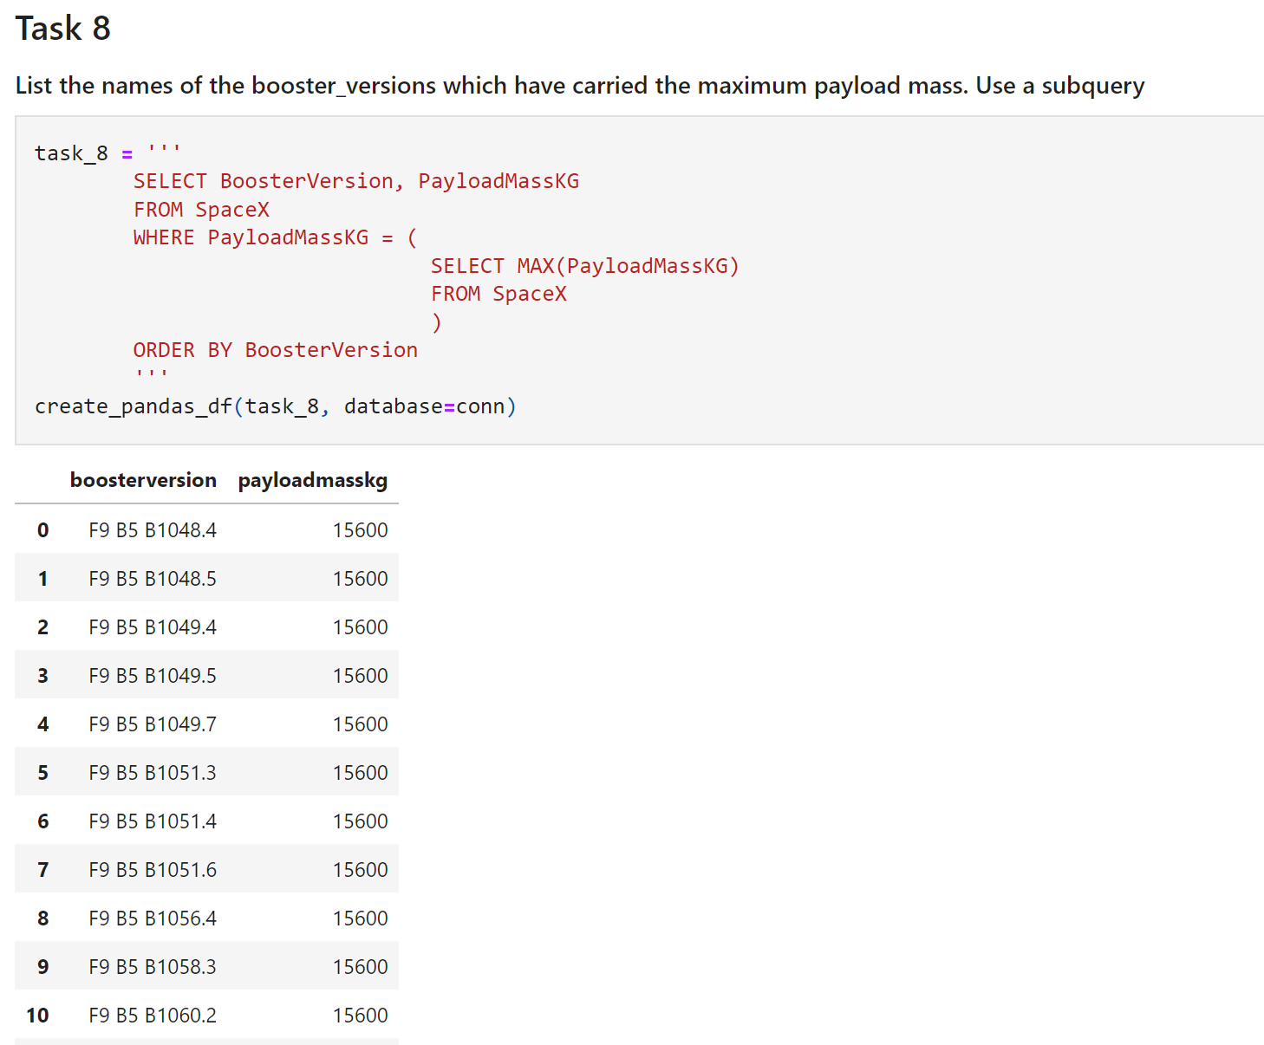
Boosters Carried Maximum Payload
Used the MAX() function to determine which booster carried the maximum mass payload.

Slide 32
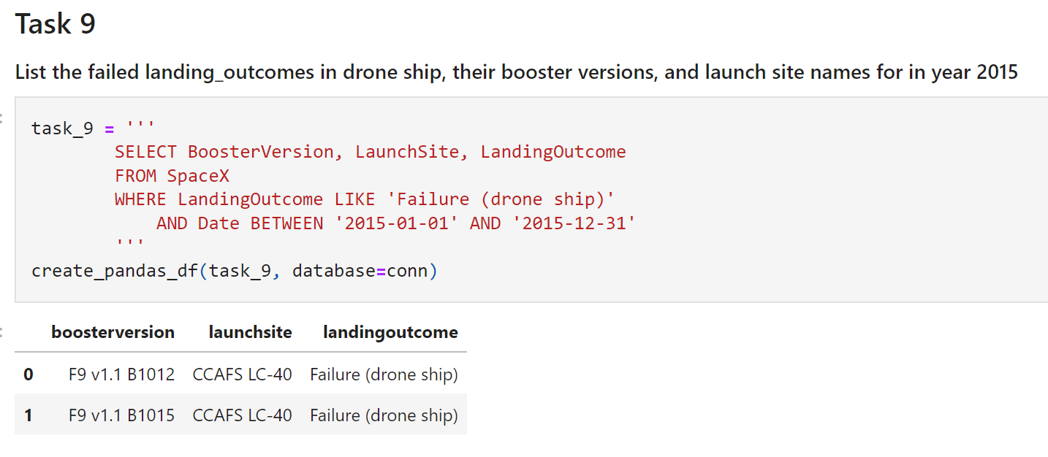
2015 Launch Records
Used a combination of the WHERE, LIKE, AND, and BETWEEN clauses to filter for the landing outcomes in drone ship in 2015

Slide 33
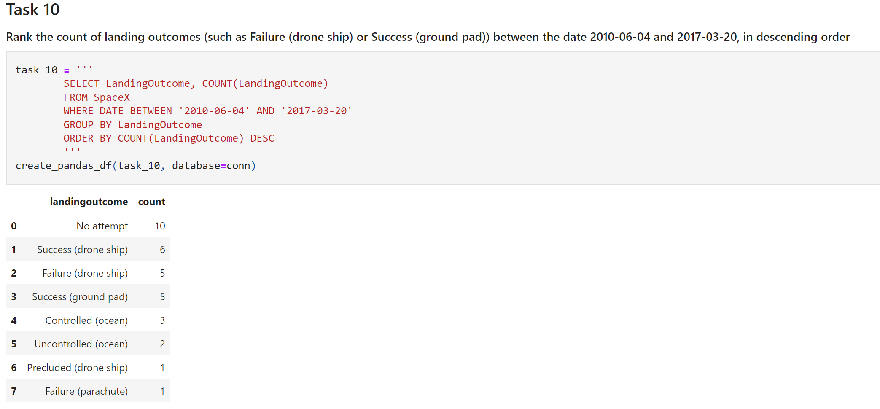
Rank Landing Outcomes Between 2010-06-04 and 2017-03-20
Applied the GROUPBY clause to group the landing outcomes and reordered the outcomes in descending order.

Slide 34


Slide 35
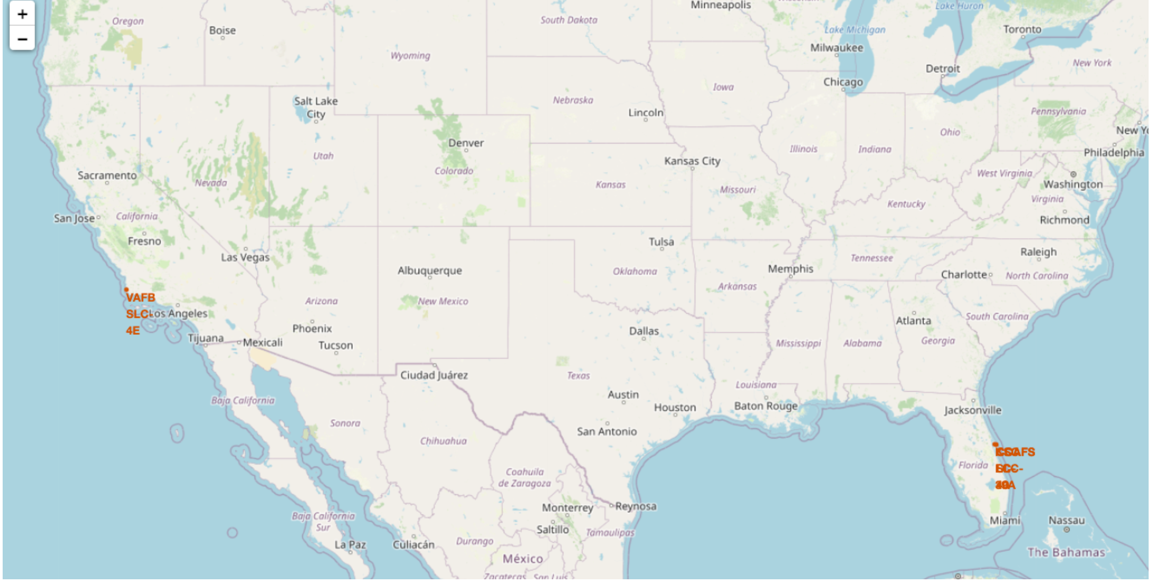
All launch sites map markers
We can conclude that all of SpaceX launch sites are close to the coast

Slide 36
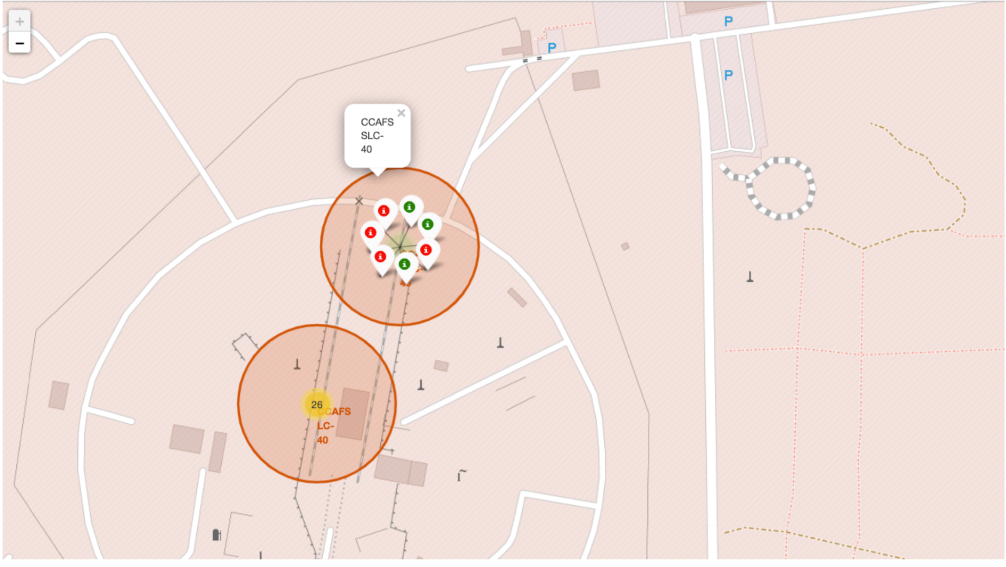
Markers showing color labeled launch sites
Green markers represent successful launches while Red markers represent failed launches.

Slide 37


Slide 38
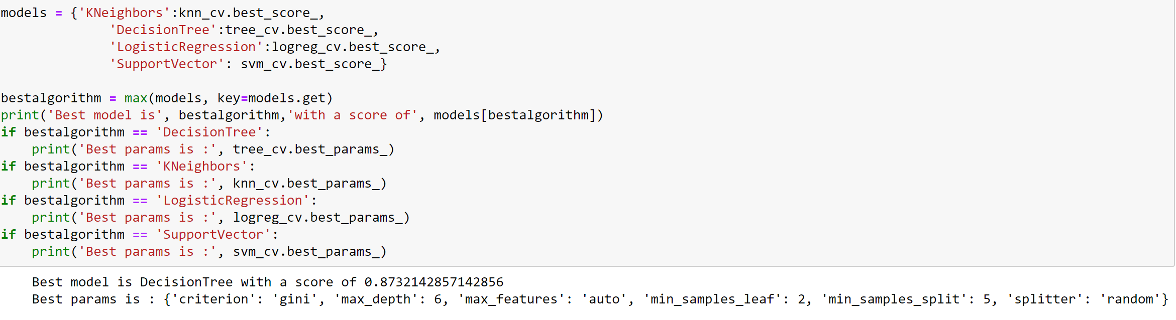
Classification Accuracy
The decision tree classifier is the model with the highest classification accuracy

Slide 39
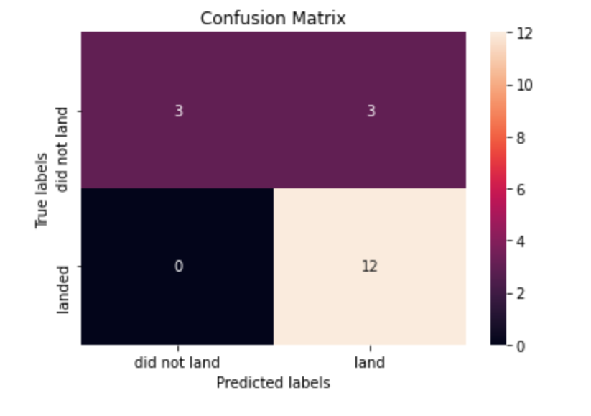
Confusion Matrix
The confusion matrix for the decision tree classifier shows that the classifier can distinguish between the different classes.

Slide 40
Conclusions
We can conclude that:
The greater the number of launches at a site, the greater the success rate
KSC LC-39A was the most successful launch site
The Decision tree classifier is the best machine learning algorithm for this project

Slide 41


